Slide 1
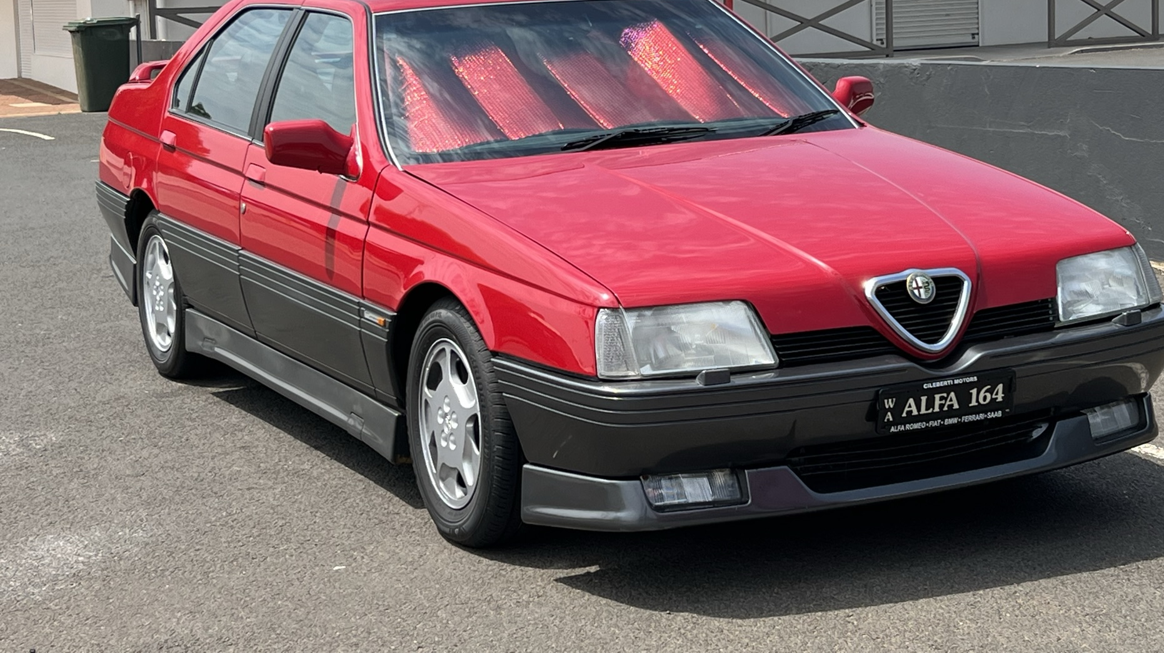
Tipo 4

Slide 2
Fiat & Saab had started on joint platform in 1979
Then expanded to include Lancia and Alfa
Tipo 4 , Platform 4
Alfa design – lower front end
Reason for the famous chrome inlet pipes on the Busso V6
Launched at Frankfurt Motor show 87

Slide 3
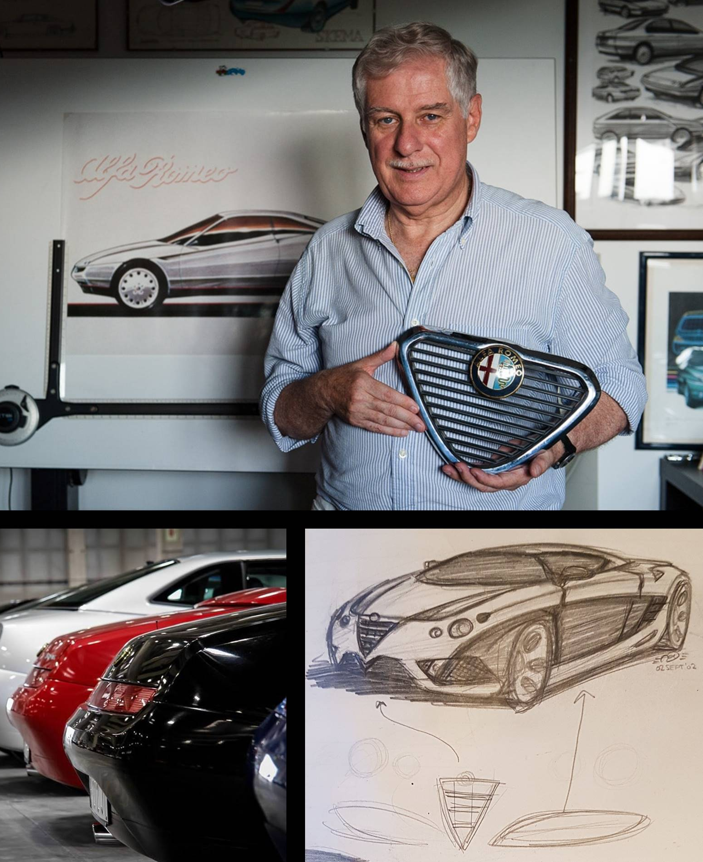
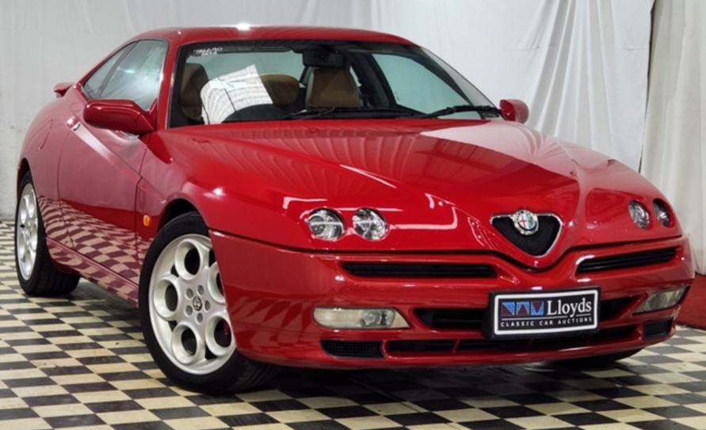
Designer Enrico Fumia
Pininfarina
Also responsible for GTV (916)
Notes:
I’ll come back to this GTV

Slide 4
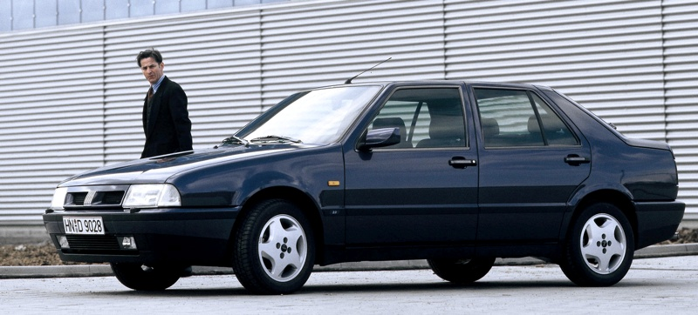
Notes:
Irish car of the year 87
Fiat wont 4 times in 80s
Alfa have never won

Slide 5
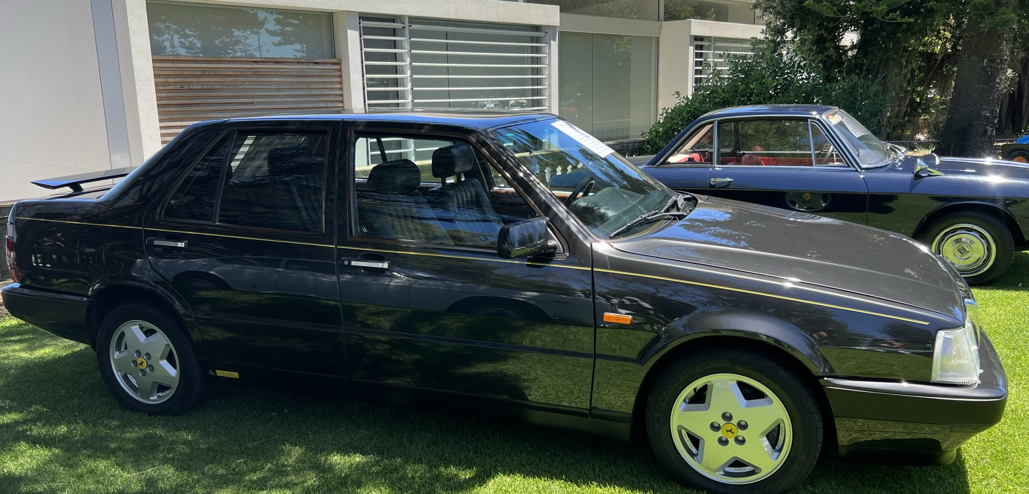
Notes:
Celebration of the Motorcar – notice the wheels
8 cyclinder
32 valve
Ferrari 308

Slide 6
Alfa Romeo Gulia
2021 | 6,297
2020 | 7,436
2019 | 10,932
2018 | 17,075
2017 | 24,679
2016 | 10,475
Total | 76,894
Alfa 164
270,000 units sold
Last Alfa sold in the USA until 2006
Alfa 156
670,000 units

Slide 7
Mix of engines, 12v 3.0 Busso V6
2 litre turbo in Italy to avoid tax on larger engines
24v 3.0litre V6 – not sold in Aus
Very rare 4x4 Q4 in LHD only 236BHP
Asian Market ….

Slide 9
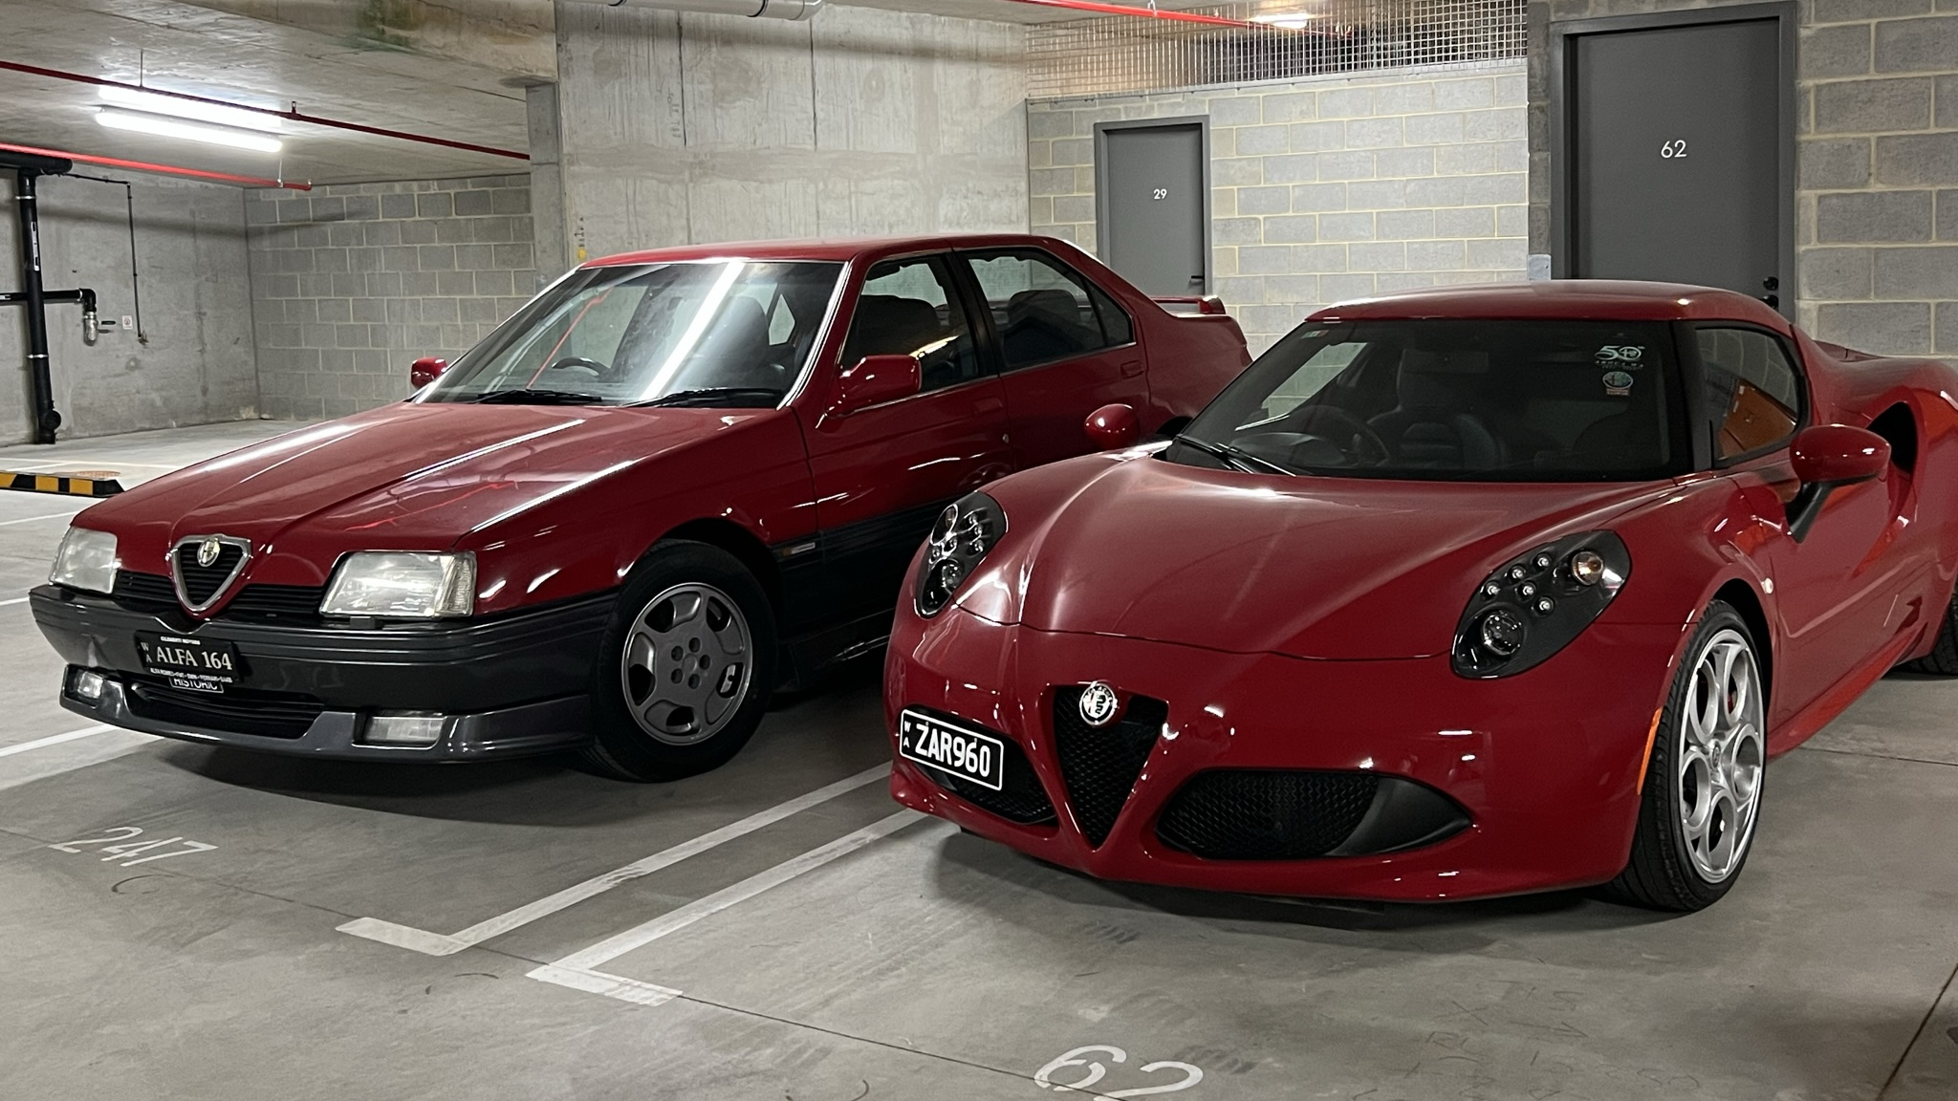
Notes:
Not my car space

Slide 10
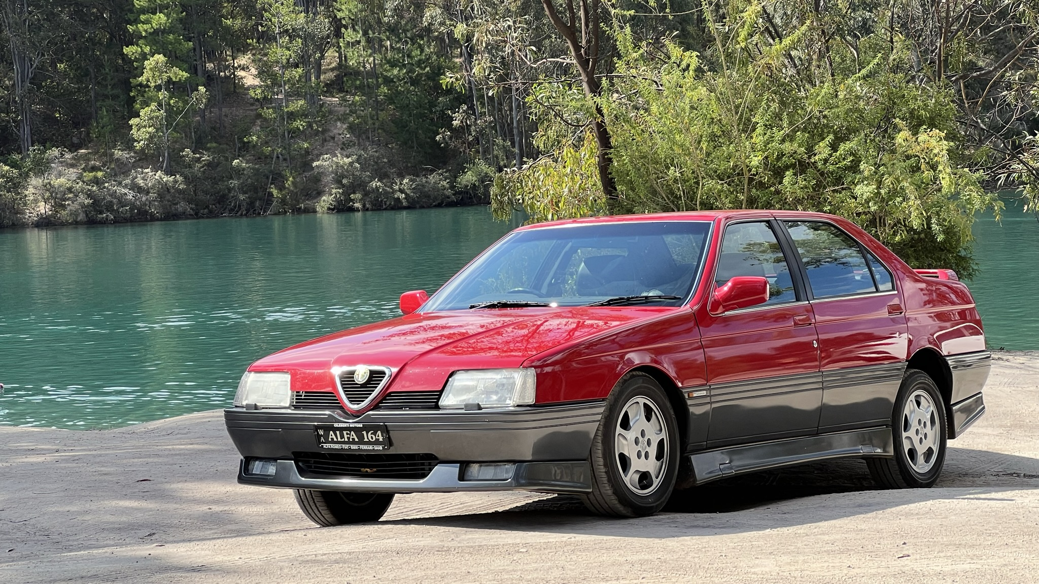

Slide 11
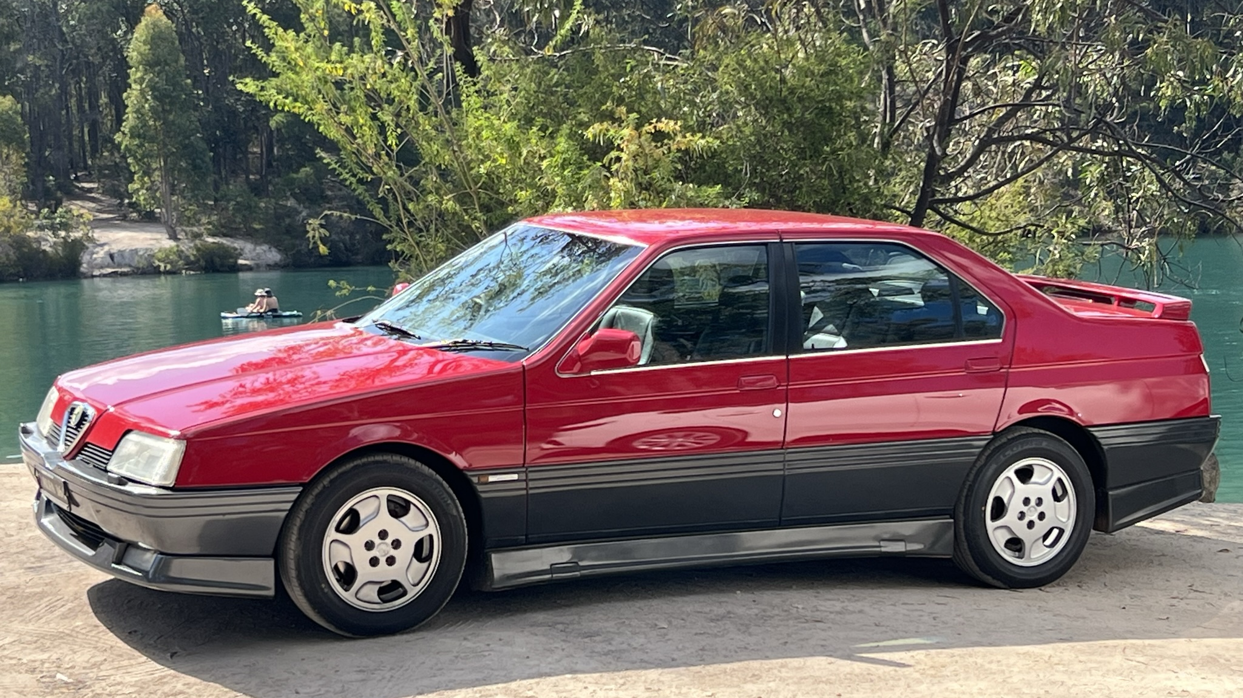

Slide 12
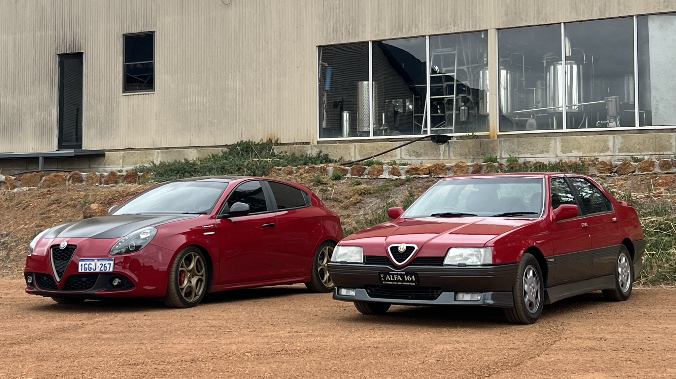

Slide 13
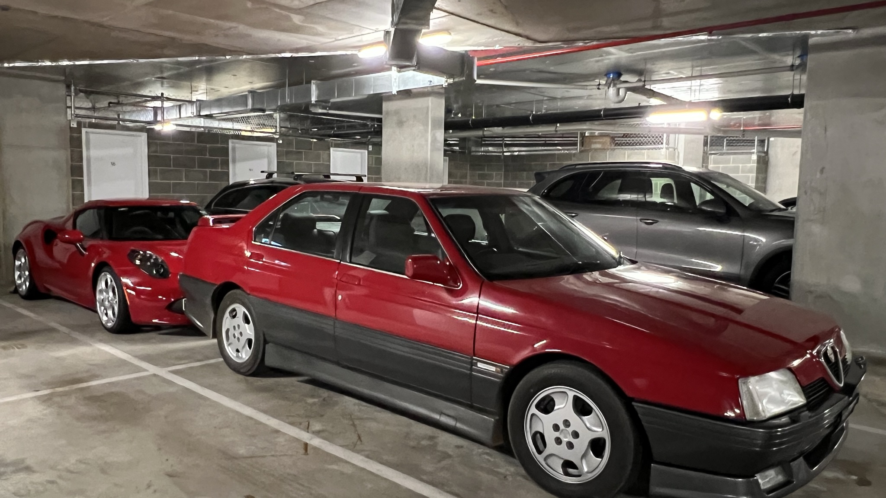

Slide 14
Special editions

Slide 15
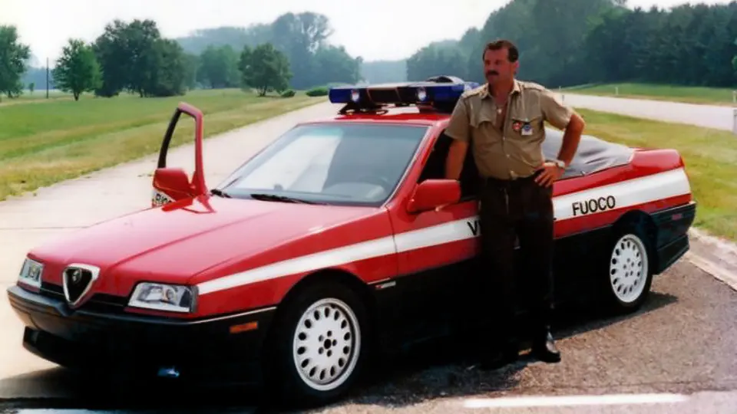

Slide 16
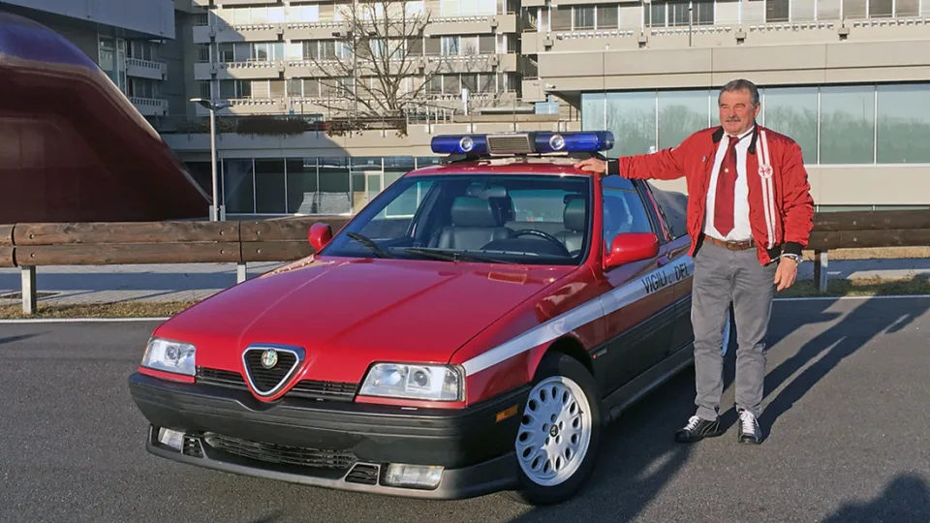

Slide 17
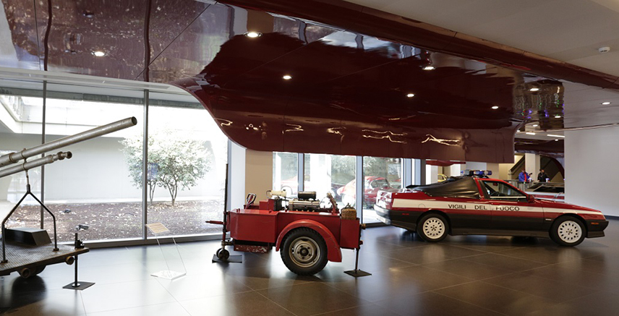
Notes:
Recent talk at the museum by the driver

Slide 18
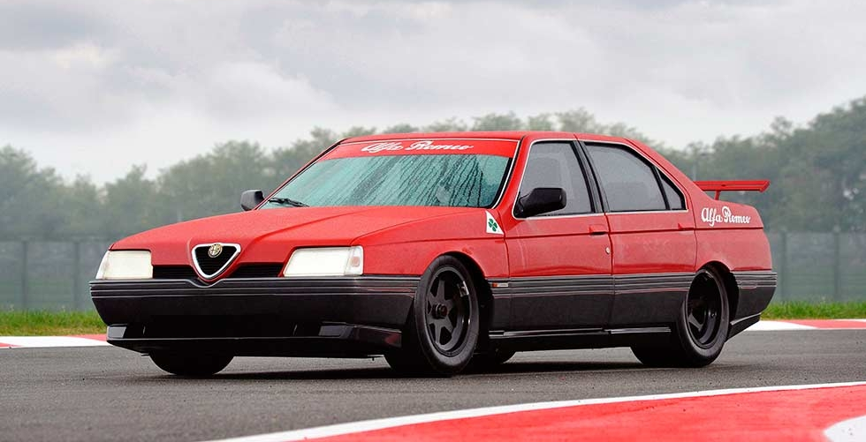

Slide 19
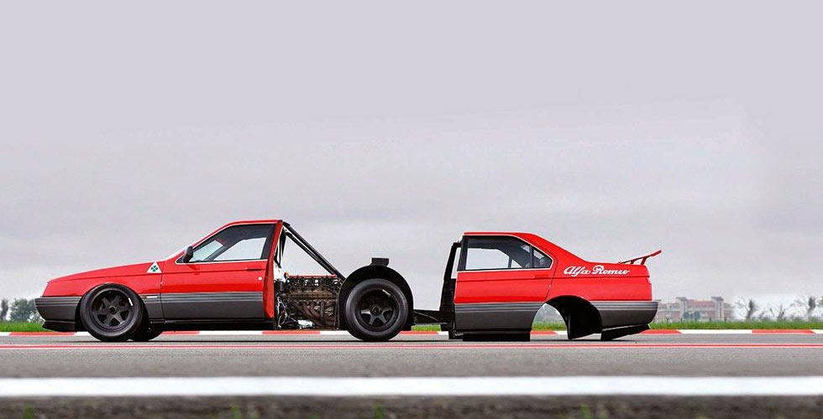

Slide 20
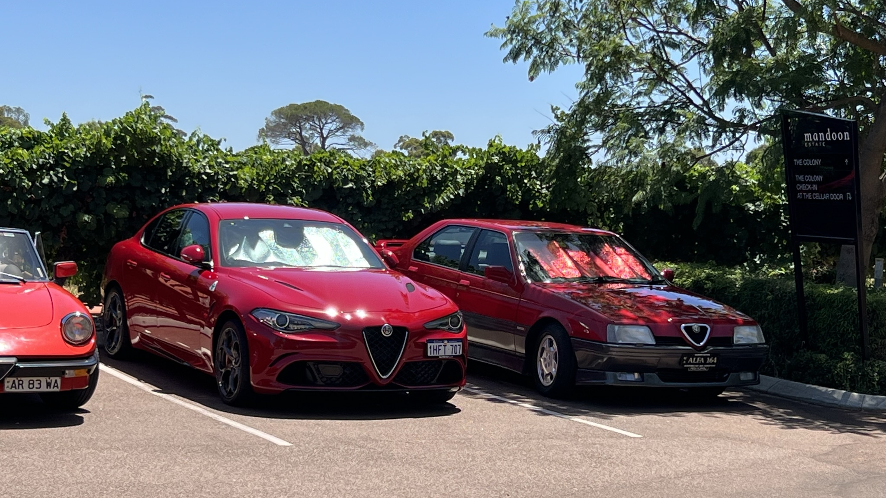

Slide 21
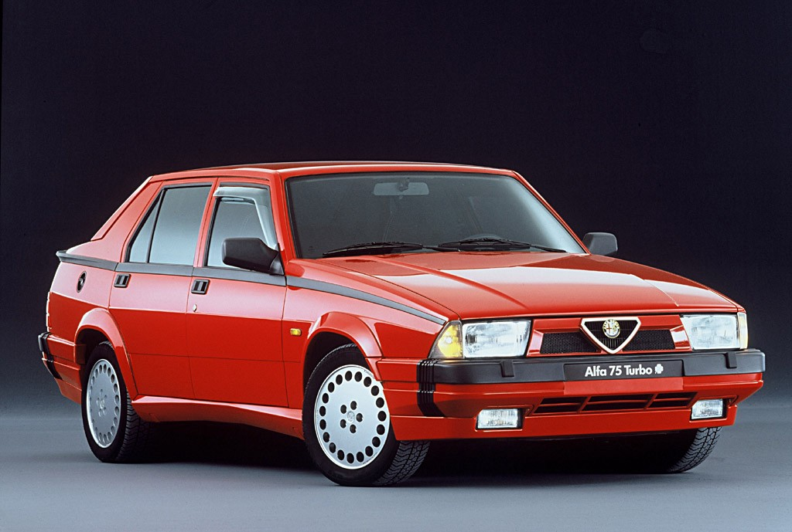
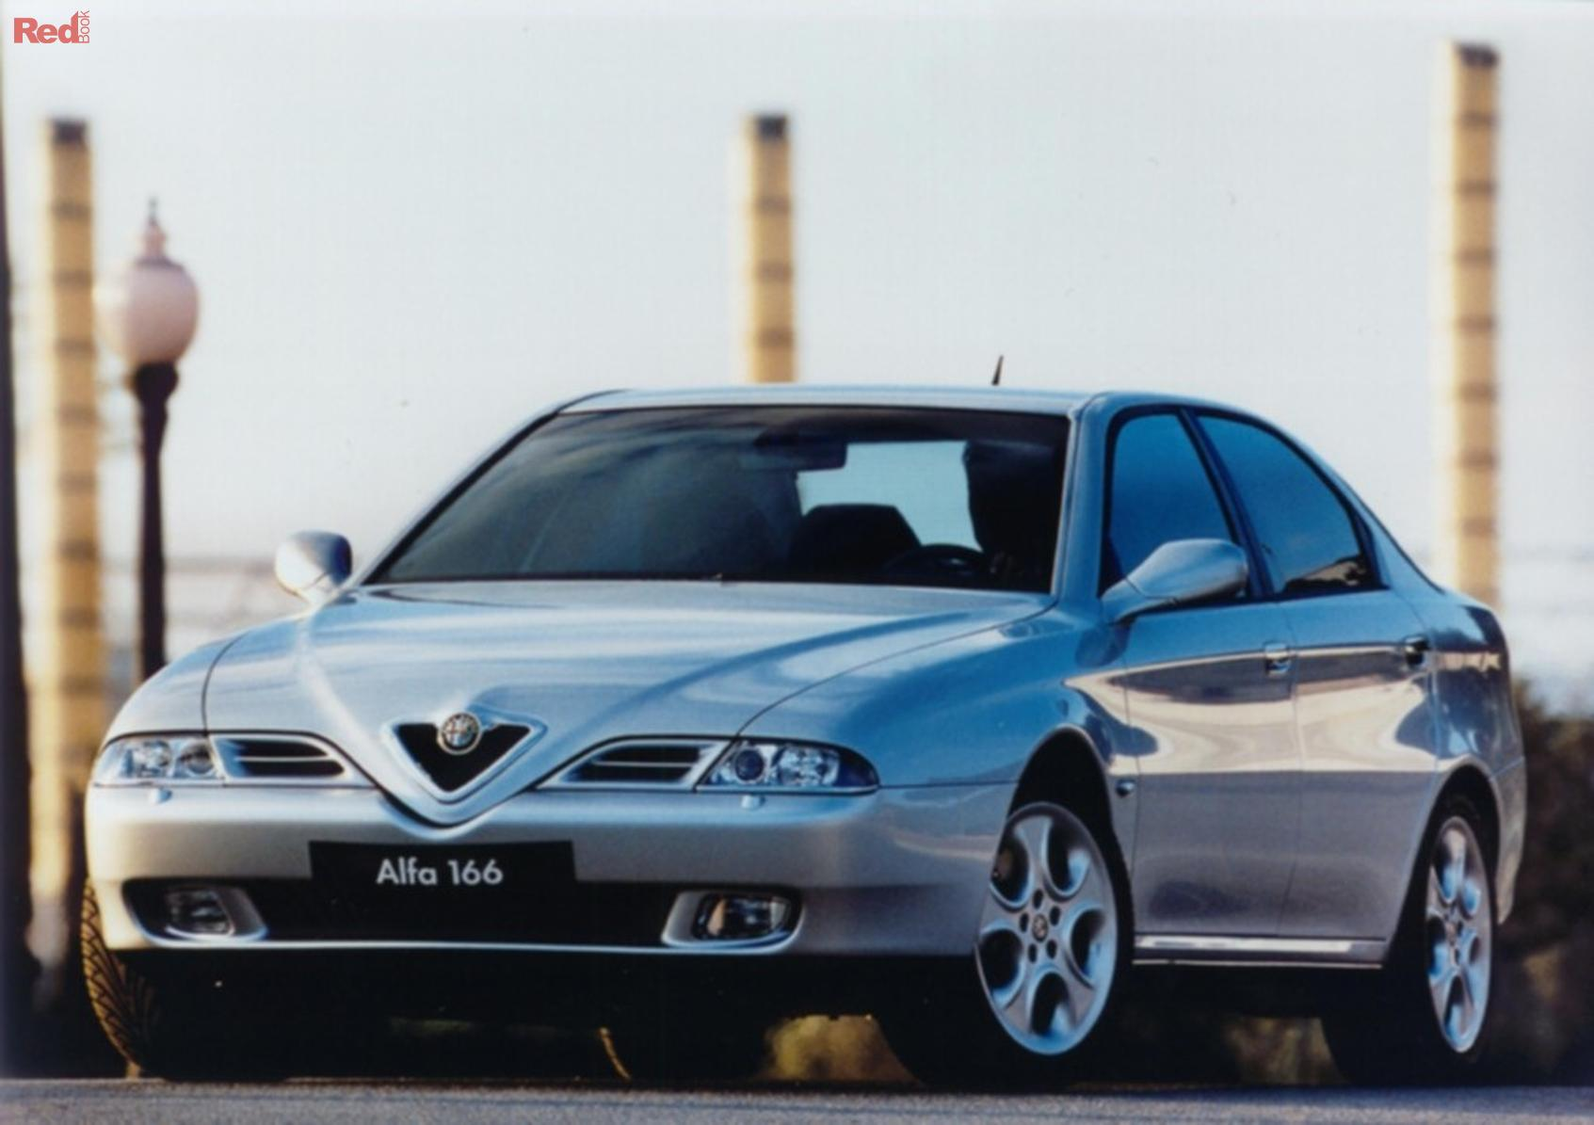
Before
After
Notes:
Aidan – future plans
Suspension – active
Wheel nuts – from Sweden

